Slide 1
Focus on Pharmacology:
Essentials for Health Professionals
Third Edition
Chapter 20
Vaccines and Immunoglobulins

Slide 2
Introduction
Immunizing agents and allergenic extracts are two of the main groups of drugs that are classified as biologics by the FDA.
Biologics possibly have prevented more morbidity and mortality than all other drugs combined.

Slide 3
The Immune System
Part of the lymphatic system
Removes foreign substances from blood and lymph
Combats infectious diseases
Maintains tissue fluid balance
Absorbs fats
continued on next slide

Slide 4
The Immune System
Invading microorganisms and foreign substances cause production of more lymphocytes (white blood cells)
Lymphocytes
  Create special proteins called antibodies.
  Are the dominant cells
  Respond to:
    Invading pathogens
    Abnormal body cells (such as cancer)
    Foreign proteins (such as toxins)
continued on next slide

Slide 5
The Immune System
Specific defenses (immune responses)
  Compromise immunity
Immunity
  Ability to resist infection and disease through activation of specific defenses
continued on next slide

Slide 6
The Immune System
Network of lymphatic vessels from peripheral tissues to venous system
Lymph
  Fluid flowing through lymphatic vessels
Lymphoid organs
  Lymph nodes, spleen, thymus, and more
  Connected to vessels
  Have large numbers of lymphocytes

Slide 7
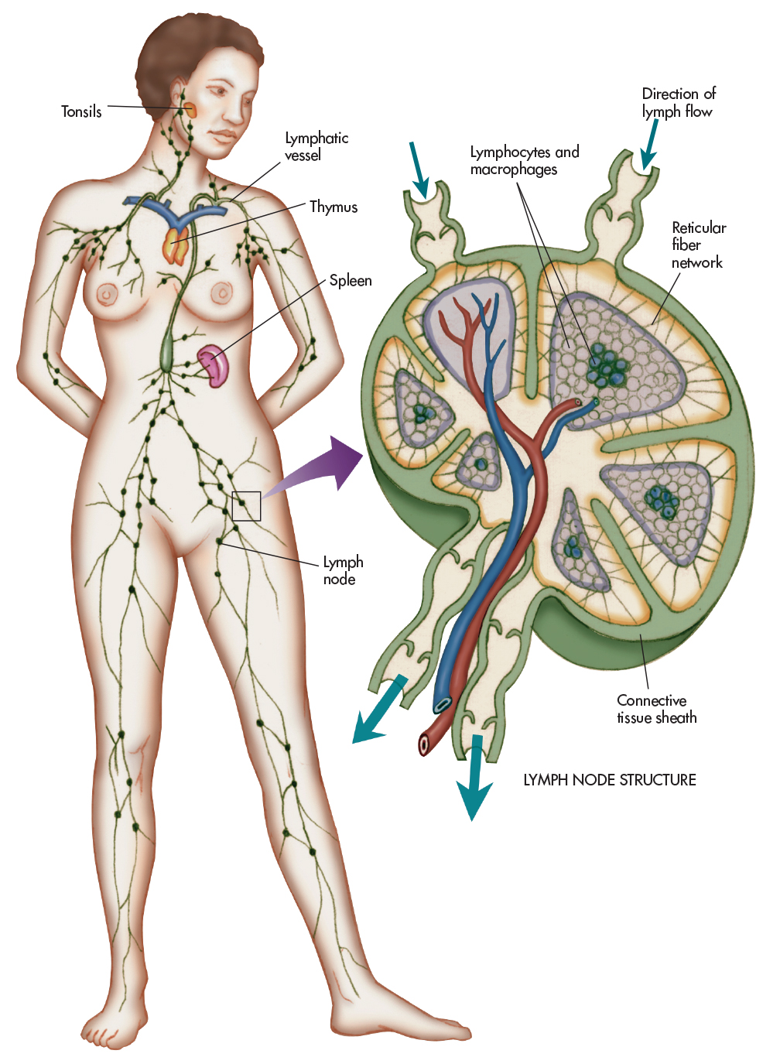
Figure 20-1 The lymphatic system includes the tonsils, lymph nodes, spleen, and lymphatic vessels. Within the lymph nodes are the macrophages and lymphocytes.

Slide 8
The Immune System
Lymphocytes
  T cells (thymus-dependent)
    80% of circulating lymphocytes
    Cytotoxic T cells directly attack:
      Foreign cells
      Body cells infected with viruses
    Primary cells that provide cell-mediated immunity
continued on next slide

Slide 9
The Immune System
Lymphocytes
  B cells (bone marrow-derived)
    10%-15% of circulating lymphocytes
    Can differentiate into plasma cells
      For production, secretion of antibodies
      Often called Immunoglobulins or Igs
    Antibodies react with antigens
      Usually pathogens, derived from pathogens, or other foreign compounds
continued on next slide

Slide 10
The Immune System
Lymphocytes
  Natural killer (NK) cells
    5%-10% of circulating lymphocytes
    Attack:
      Foreign cells
      Virus-infected cells
      Cancer cells appearing in normal tissues

Slide 11
Cell-Mediated Immunity and Humoral Immunity
T lymphocytes
  Immune cells derived from monocytes
  Sensitized by first contact with a specific antigen
  Along with macrophages, they destroy antigens.
    Attack antigens directly, don’t produce antibodies
  Lost cell-mediated immunity, as in AIDS:
    Body cannot protect itself against many viral, bacterial, and fungal infections.
continued on next slide

Slide 12
Cell-Mediated Immunity and Humoral Immunity
B cells
  Produce circulating antibodies to act against antigen
    Released into circulation at lymph nodes
  Form
    Daughter lymphocytes that develop into plasma cells
  Some activated B cells turn into memory cells.
    Continually produce small amounts of antibody after infection is overcome

Slide 13
Immunity
Normally acquired by contracting a disease, then developing immunity to it.
Being vaccinated with proteins from causative agent
Two main types of immunity:
  Active
  Passive
continued on next slide

Slide 14
Immunity
Active Immunity
  A form of acquired immunity
    Develops in response to an immunogen (antigen)
    Naturally acquired by exposure to an infectious disease, or
    Artificially acquired by receiving active immunizing agents (vaccines)
  Vaccination = active immunization
continued on next slide

Slide 15
Immunity
Passive Immunity
  Effectors of immunity (immunoglobulins or antibodies):
    From one immune individual to another
  Immunoglobulin G (IgG) antibodies
    From mother to fetus, across placental barrier
  Onset of passive immunity is quicker.
    However, of shorter duration than active immunity

Slide 16
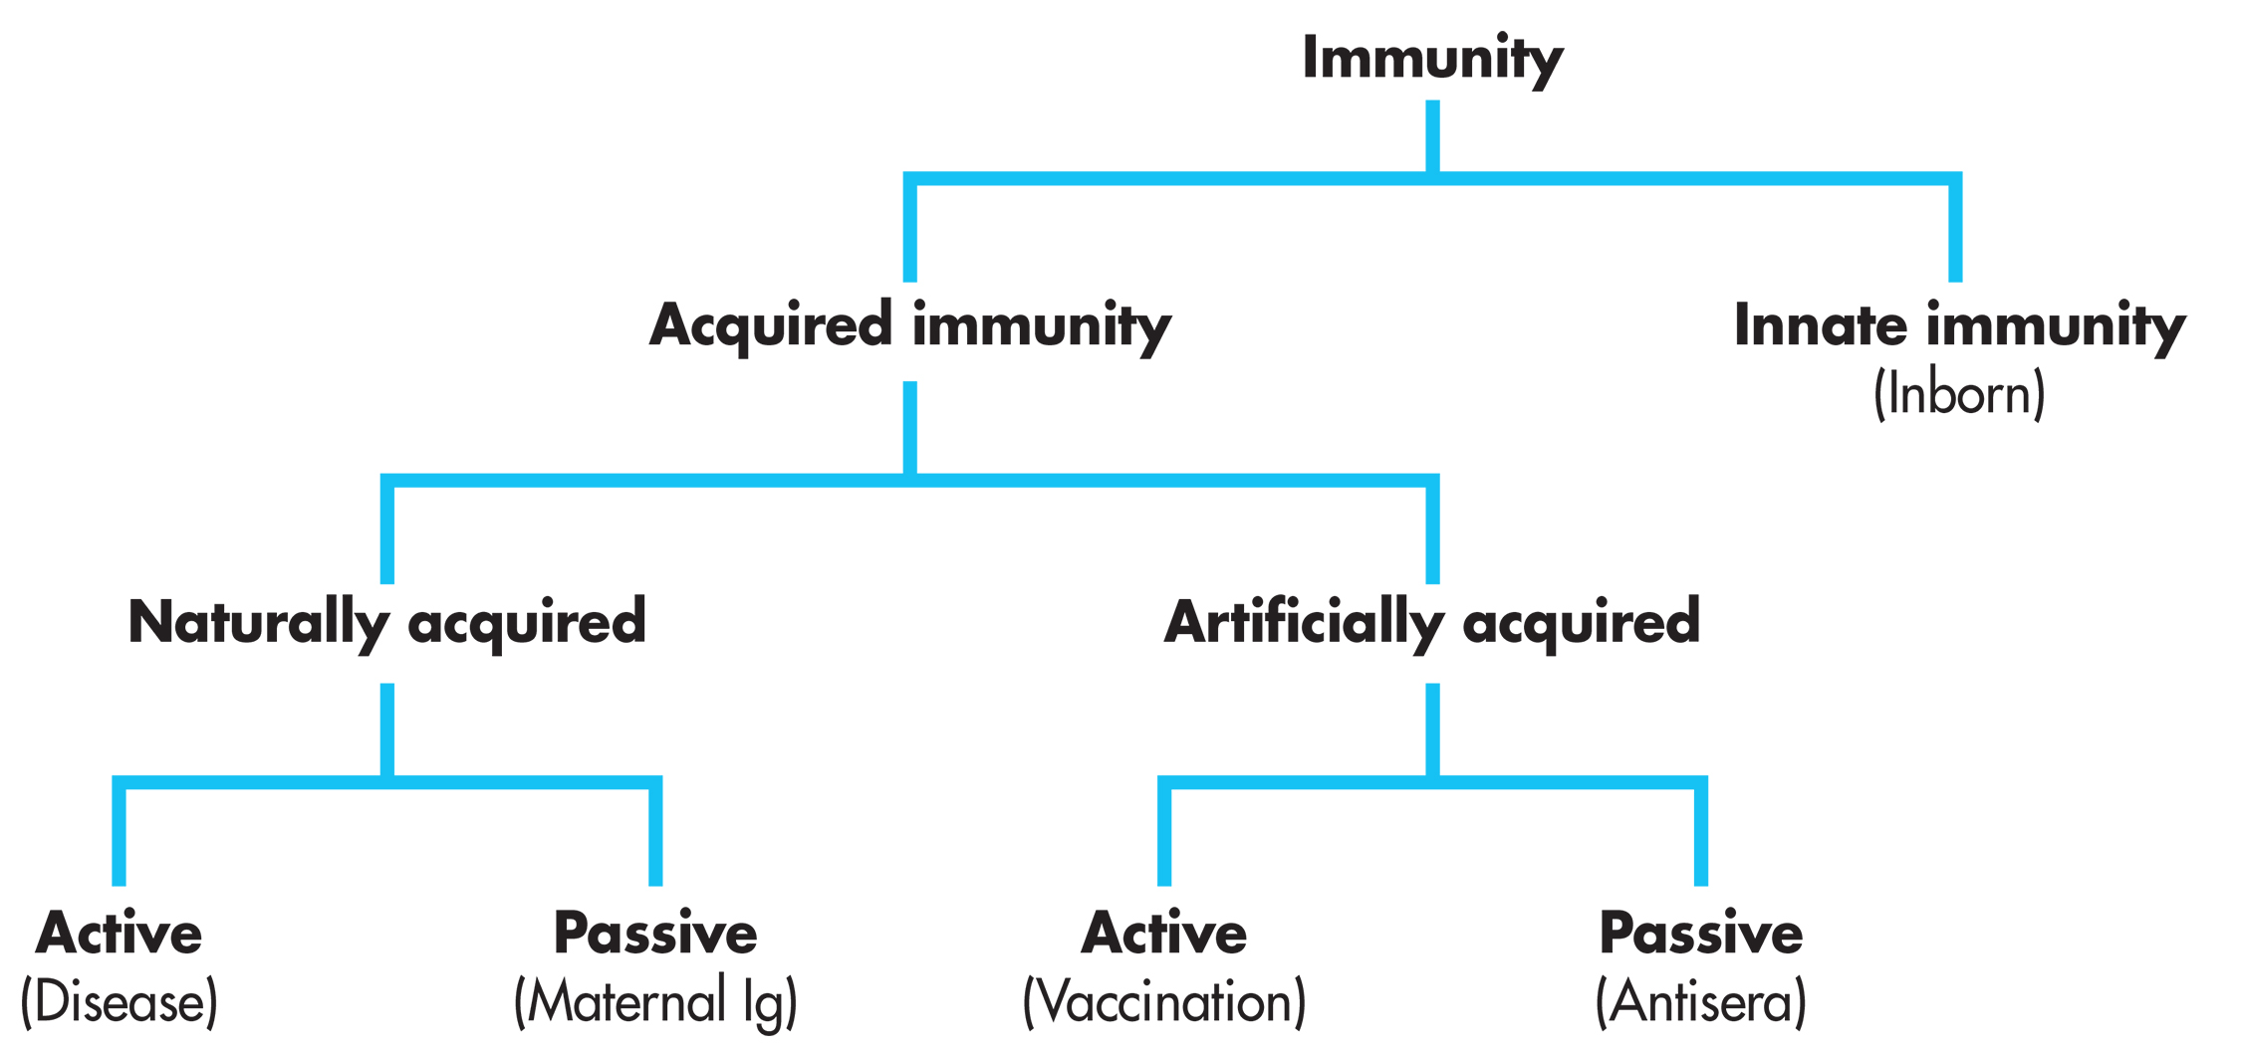
Figure 20-2 Types of immunity.

Slide 17
Immunizing Agents
Vaccine
  Produces or artificially increases immunity to a disease
  May contain:
    Killed microorganisms
    Living attenuated (reduced virulence) organisms
    Living virulent organisms
continued on next slide

Slide 18
Immunizing Agents
Active Immunizing Agents
  Main action is to prevent, not treat disease.
    Most common vaccines are highly effective
  Very safe
  Generally available at low cost
continued on next slide

Slide 19
Immunizing Agents
Active Versus Passive Agents
  Active
    Usually administered before disease exposure
    Provide long-term, even permanent, protection
  Passive
    Older than active agents
    With various antitoxins derived from animals
    Problems in efficacy and safety
continued on next slide

Slide 20
Immunizing Agents
Vaccines
  Most bacterial vaccines contain killed bacteria or their components.
  In the lab, a bacterium is developed that lacks a toxin, enzyme, or other normal constituent.
  Another type contains toxoids (protein toxins)
    Modified to reduce hazardous properties
      Without greatly altering antigenic properties
      Oldest examples include diphtheria and tetanus toxoid.
continued on next slide

Slide 21
Immunizing Agents
Vaccines
  Relatively harmless form sensitizes immune cells
    For possible re-exposure to the organism
    Triggers a quicker immune response
  Used for many bacterial infections
    Also used for lesser amounts of viral infections
continued on next slide

Slide 22
Immunizing Agents
Vaccines
  Adverse effects
    Injection site reactions
    Fever
    Headache
    Malaise
    Nausea
    Dizziness
continued on next slide

Slide 23
Immunizing Agents
Vaccines
  Contraindications
    Acute fever
    Pregnancy
    Lactation
    Previous anaphylaxis
  Interactions
    Concurrent vaccines
continued on next slide

Slide 24
Immunizing Agents
Vaccines
  Monitor injection site for reactions.
  No breastfeeding until physician approves

Slide 25
Table 20-1 Bacterial Vaccines
VACCINE | ROUTES OF ADMINISTRATION
Live Attenuated Vaccines
Bacillus Calmette Guérin (BCG) vaccine* | Intradermal
Typhoid vaccine | PO or IM
Inactivated Vaccines
Anthrax vaccine, adsorbed | SC or IM
Cholera vaccine | PO
Haemophilus influenzae type b (Hib) | IM
*Bacillus Calmette Guerin (BCG) vaccine is not generally recommended for use in the United States because of a low risk of infection with Mycobacterium tuberculosis and other reasons. It should be considered only for people who meet specific criteria determined by a tuberculosis expert. PO, oral; IM, intramuscular; SC, subcutaneous.
continued on next slide

Slide 26
Table 20-1 Bacterial Vaccines
VACCINE | ROUTES OF ADMINISTRATION
Inactivated Vaccines
Lyme disease vaccine (removed from U.S. market due to low demand) | IM
Meningococcal polysaccharide vaccine | SC
Pertussis vaccine, adsorbed | IM
Pneumococcal conjugate vaccine (Prevnar 13) | IM
Tetanus toxoid, adsorbed | IM
*Bacillus Calmette Guerin (BCG) vaccine is not generally recommended for use in the United States because of a low risk of infection with Mycobacterium tuberculosis and other reasons. It should be considered only for people who meet specific criteria determined by a tuberculosis expert. PO, oral; IM, intramuscular; SC, subcutaneous.

Slide 27
Table 20-2 Inactivated Virus Vaccines
VACCINE | ROUTES OF ADMINISTRATION
Hepatitis A vaccine | IM
Hepatitis B vaccine | IM
Influenza virus vaccine (types A and B) | IM
Poliovirus vaccine, inactivated | SC or IM
Rabies virus vaccine | IM
Note: The measles, mumps, and rubella (MMR) vaccine contains live attenuated viruses and must be administered subcutaneously. IM, intramuscular; SC, subcutaneous.

Slide 28
Standards for Childhood Immunization
Childhood immunization
  One of most important public health measures
Children should be immunized against eight infectious diseases
  Also, hepatitis A
    In areas of high incidence
  Human papillomavirus

Slide 29
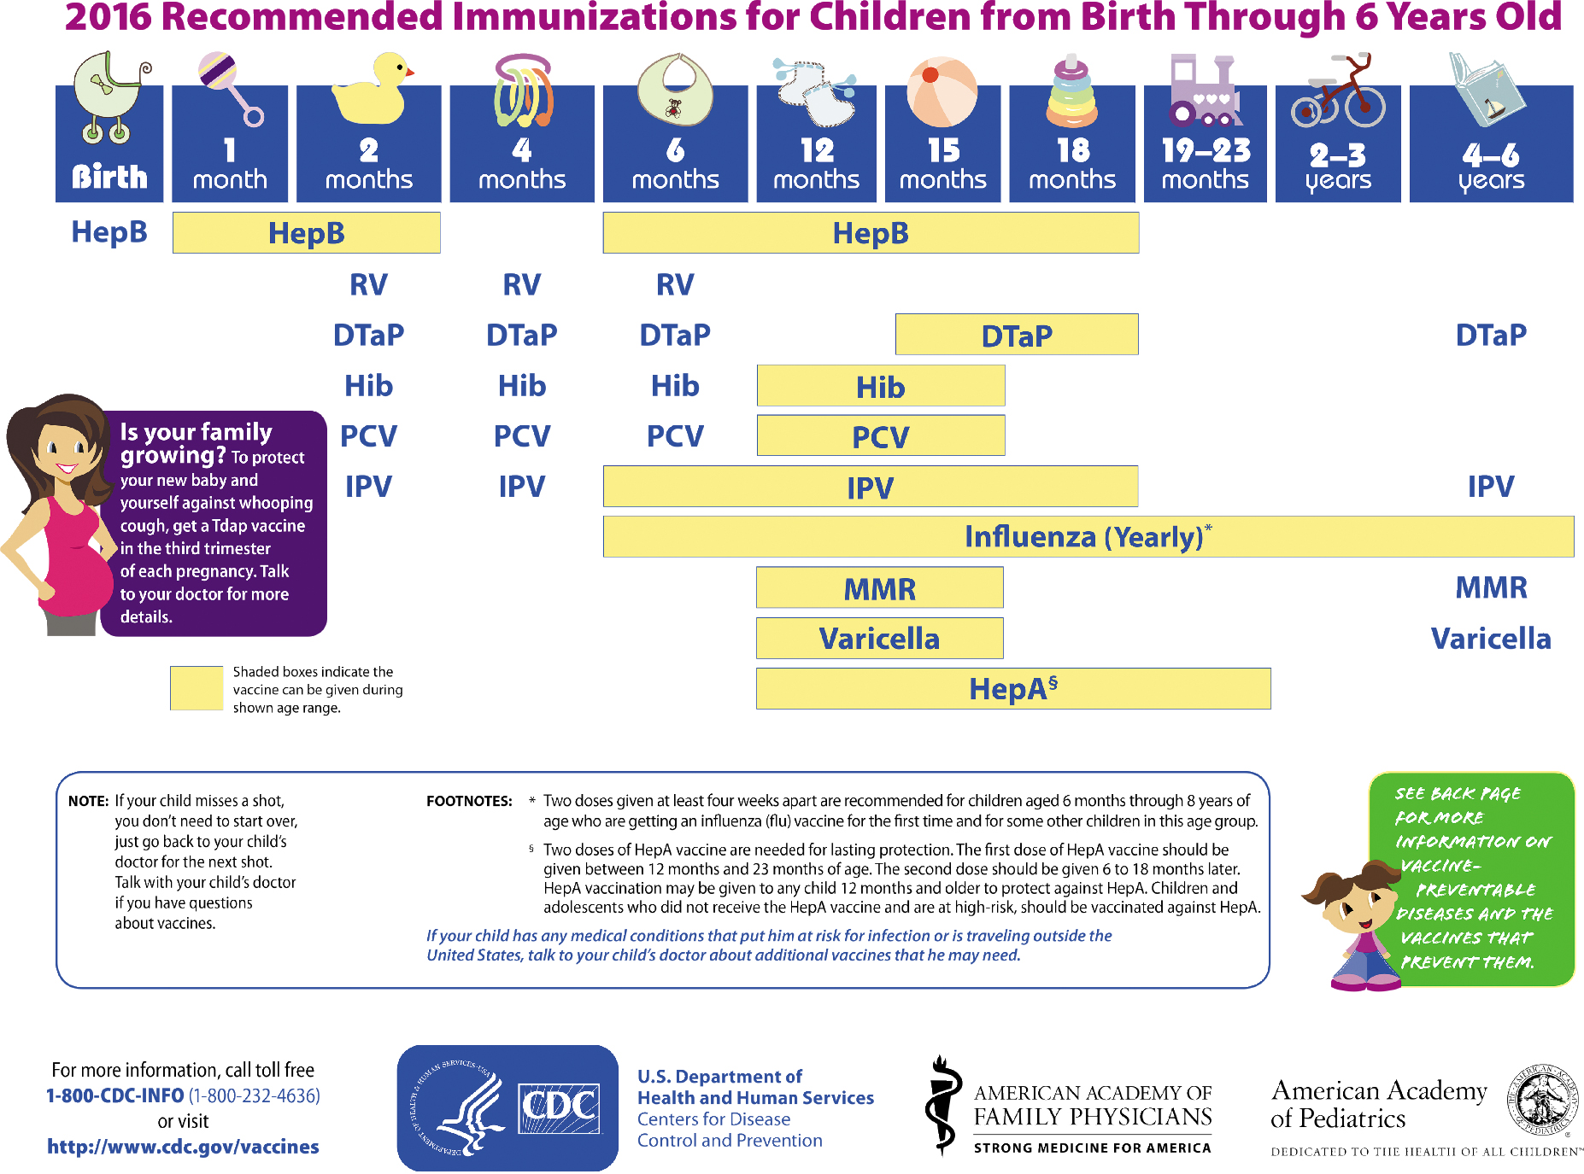
Table 20-3 Recommended immunization Schedule for persons ages 0–6 years—United States, 2016

Slide 30
Standards of Immunization for Adults Age 65 Years and Under
Only routine immunization
  Booster doses (increases effectiveness of original medication) every 10 years
    Adult diphtheria
    Tetanus toxoid
Shingles vaccine (Zostavax)
  Recommended for adults 60 and older

Slide 31
Standards of Immunization for Adults Age 65 Years and Under
Circumstances That Require Adult Booster Immunization
  Pediatric immunizations updated for:
    Who travel internationally
    Women who may become pregnant
    With chronic illnesses
continued on next slide

Slide 32
Standards of Immunization for Adults Age 65 Years and Under
Other Adult Immunizations
  Influenza (annual)
    For those at high-risk for complications
  Pneumococcal vaccine with:
    Any major immunosuppression condition
    Pulmonary or cardiovascular diseases
    Chronic hepatic or renal disorders
    Diabetes mellitus
continued on next slide

Slide 33
Standards of Immunization for Adults Age 65 Years and Under
International Adult Immunizations
  International Certificate of Vaccination
    May be required for:
      Yellow fever
      Hepatitis A (Havrix, VAQTA)
  Cholera, typhoid, and plague vaccines may be suggested.
continued on next slide

Slide 34
Standards of Immunization for Adults Age 65 Years and Under
Other Adult Immunizations
  Hepatitis B vaccine
    For health-care workers with exposure to human blood and tissues
  BCG vaccine
    For extremely high-risk individuals
    Also used to treat bladder cancer

Slide 35
Standards of Immunization for Adults Age 65 Years and Older
Boosters every 10 years
  Diphtheria
  Tetanus toxoid
Booster of pneumococcal vaccine
  If at highest risk for fatal pneumococcal disease
  Every 5 years after initial dose

Slide 36
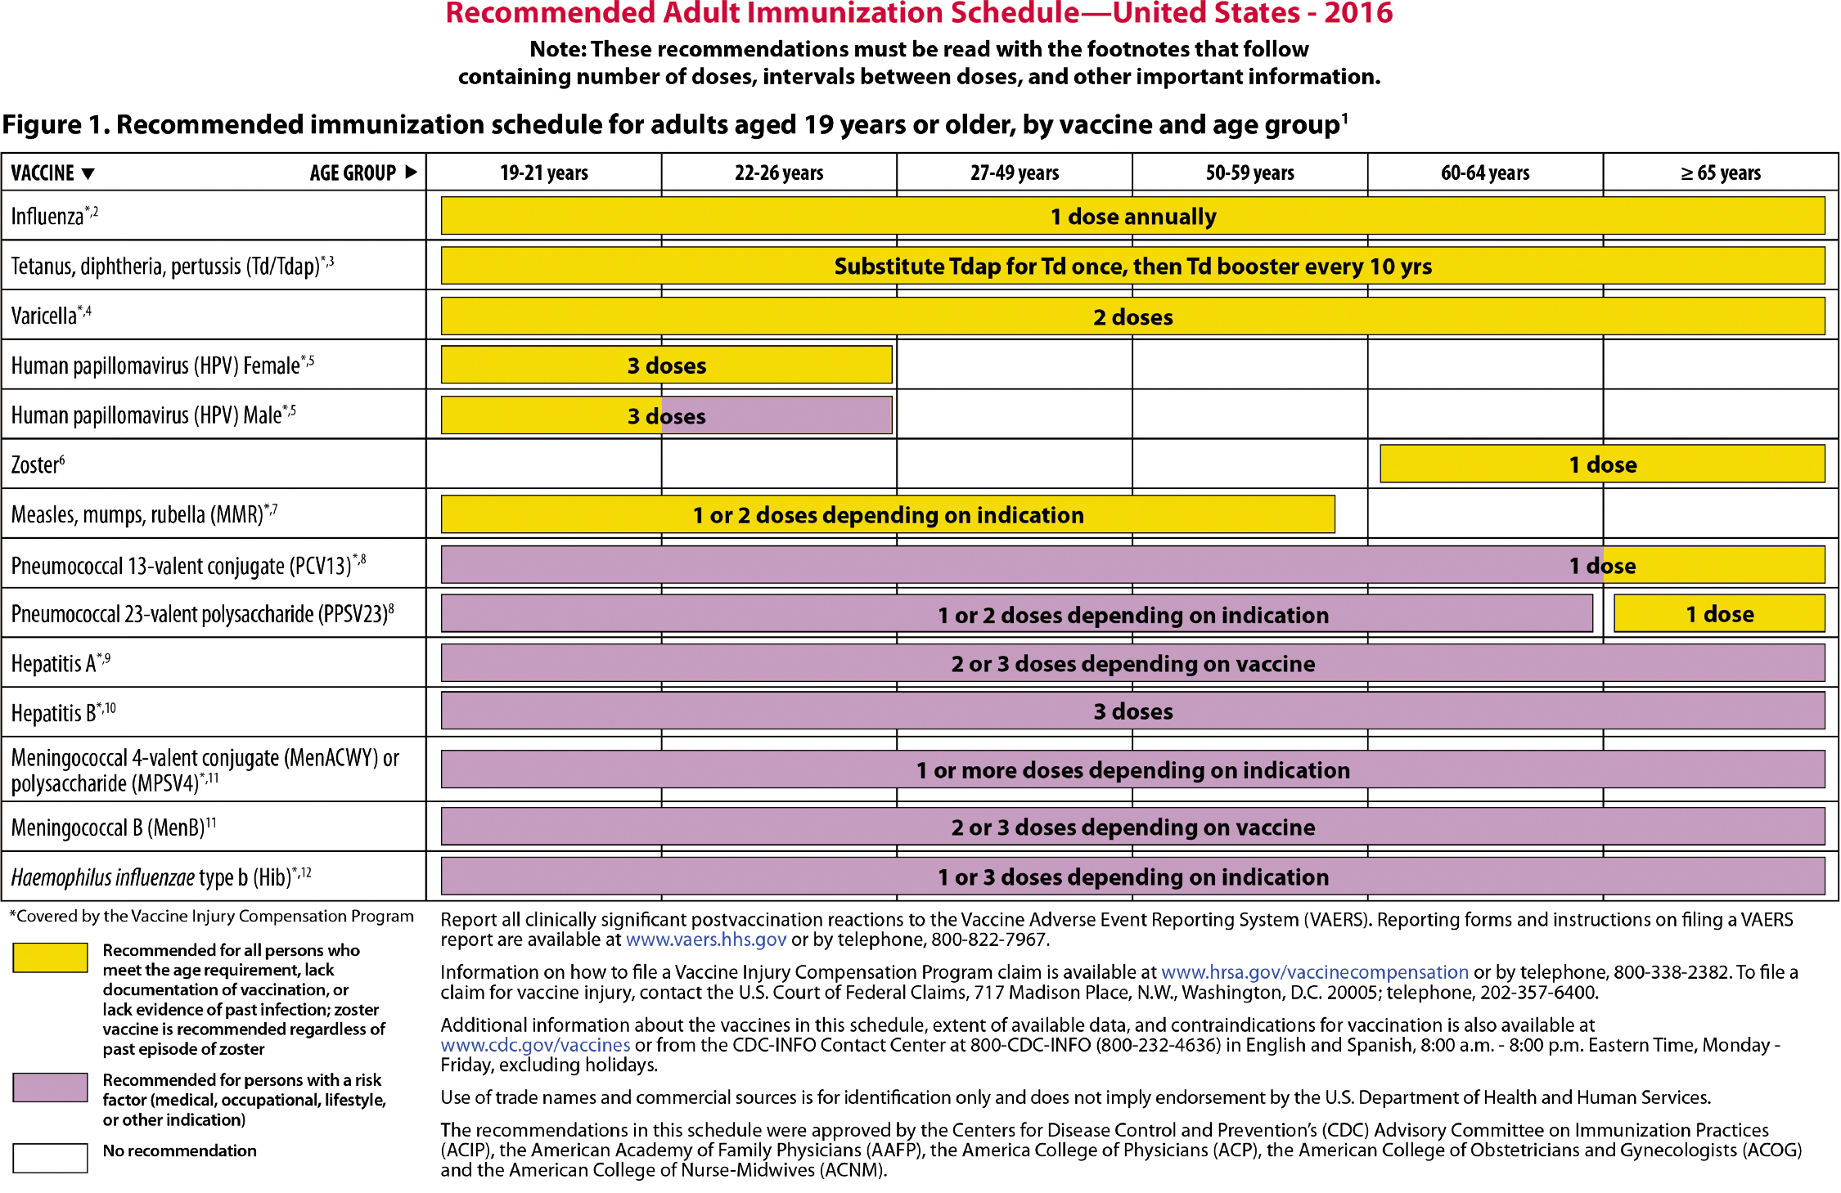
Table 20-4 Recommended Adult immunization Schedule, 2016
continued on next slide

Slide 37
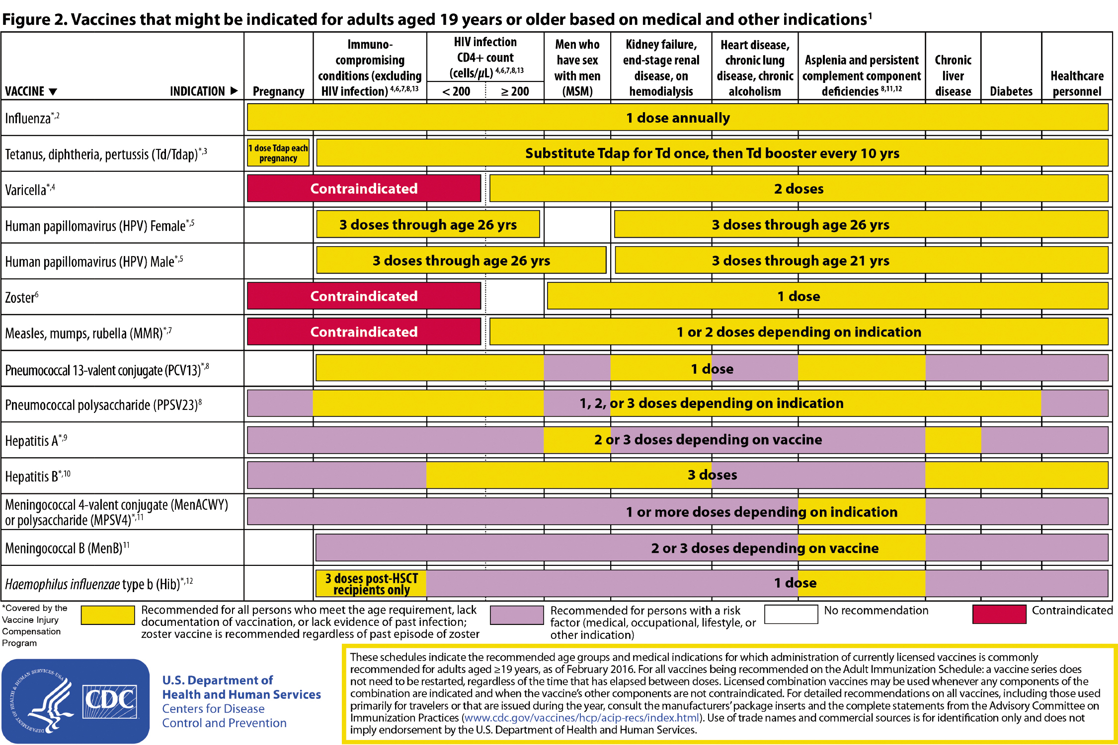
Table 20-4 (continued) Recommended Adult immunization Schedule, 2016

Slide 38
Immunoglobulins
From plasma with antibodies to specific antigens
Two types
  Intramuscular
  Intravenous
Prevent or modify hepatitis A and measles in susceptible persons (HIV positive)
continued on next slide

Slide 39
Immunoglobulins
Prevent varicella in immunocompromised patients
  If varicella-zoster immunoglobulin not available
Prevent fetal damage in women exposed to rubella during first trimester of pregnancy
continued on next slide

Slide 40
Immunoglobulins
Adverse effects
  Possible anaphylaxis possible
  Usually local pain, tenderness
continued on next slide

Slide 41
Immunoglobulins
Contraindications
  No IV use
    Due to serious anaphylactic reactions
Interactions
  None significant
continued on next slide

Slide 42
Immunoglobulins
Report:
  Signs of hypersensitivity
  Infusion symptoms
    Nausea
    Chills
    Headache
    Chest tightness
No breastfeeding until physician approves

